Slide 1


CAR PRICE PREDICTION PRESENTATION
Prepared by Poonam Kaur

Slide 2

Agenda:
Introduction
Problem Statement
Objective
Exploratory Data Analysis (EDA)
Visualization
Inference
Future Work

Slide 3
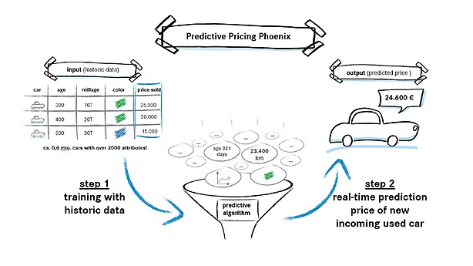
INTRODUCTION
PROBLEM STATEMENT:
With the covid 19 impact in the market, we have seen lot of changes in the car market. Now some cars are in demand hence making them costly and some are not in demand hence cheaper. One of our clients works with small traders, who sell used cars. With the change in market due to covid 19 impact, our client is facing problems with their previous car price valuation machine learning models. So, they are looking for new machine learning models from new data. We have to make car price valuation model.
This project consists on of 2 phases:

Slide 4
DATA COLLECTION PHASE:
MODEL BUILDING PHASE:
We need to scrape approx 5000 used cars data.
In this section we need to scrape the data of used cars from websites. We need web scraping for this. we have to fetch data for different locations. The number of columns for data doesn’t have limit. Generally, these columns are Brand, model, variant, manufacturing year, driven kilometers, fuel, number of owners, location and at last target variable Price of the car. This data is to give you a hint about important variables in used car model.
After collecting the data, you need to build a machine learning model. Before model building do all data pre-processing steps. Try different models with different hyper parameters and select the best model.

Slide 5
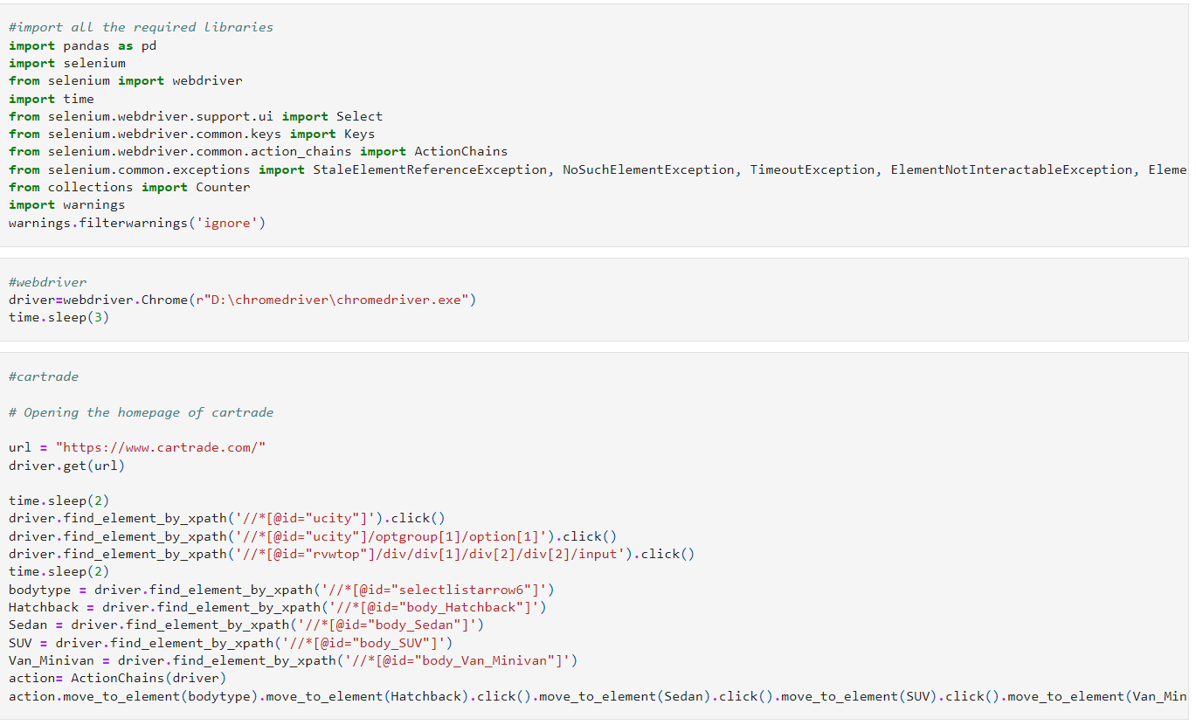
Analytical Problem Framing
With the help of Selenium I have scrapped data from different websites like cartrade, Olx and carwale and used Pandas library to save the data in excel file and csv file. Just taking a glace on basic code for scrapping from different websites.

Slide 6
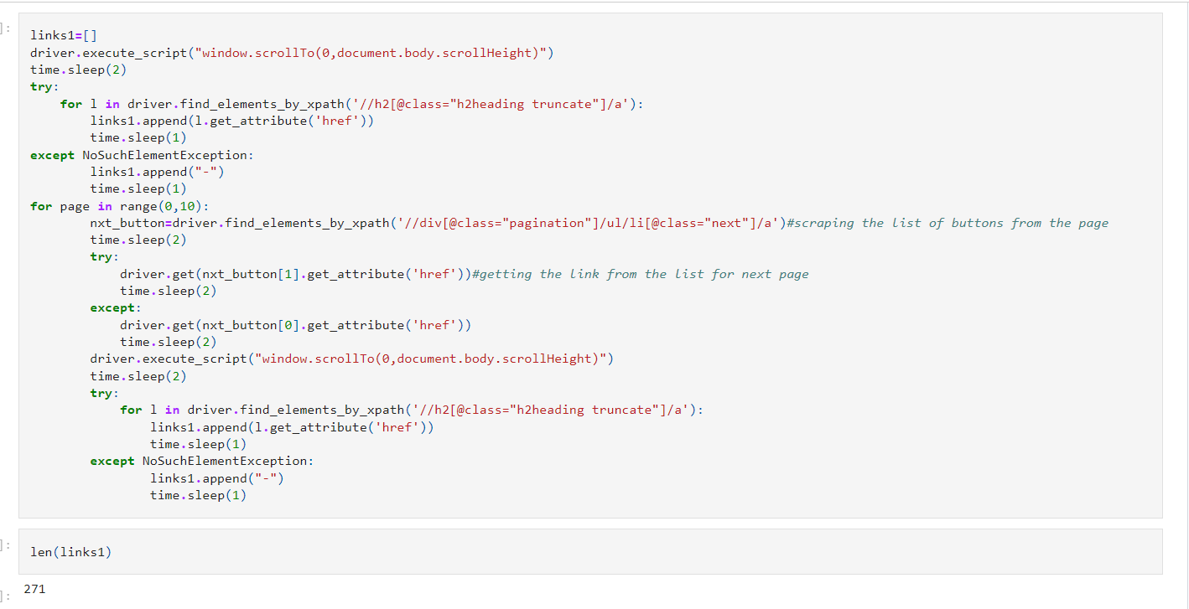
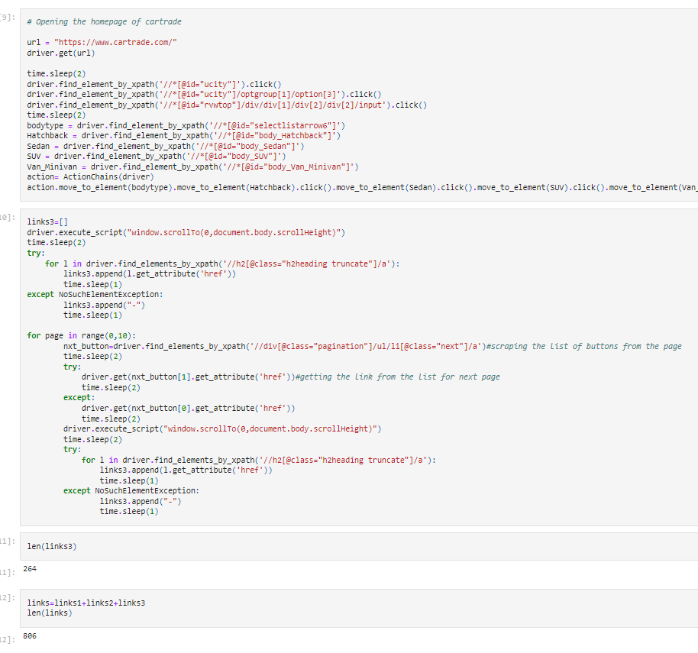

Slide 7
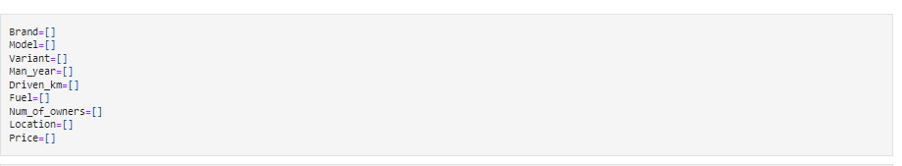
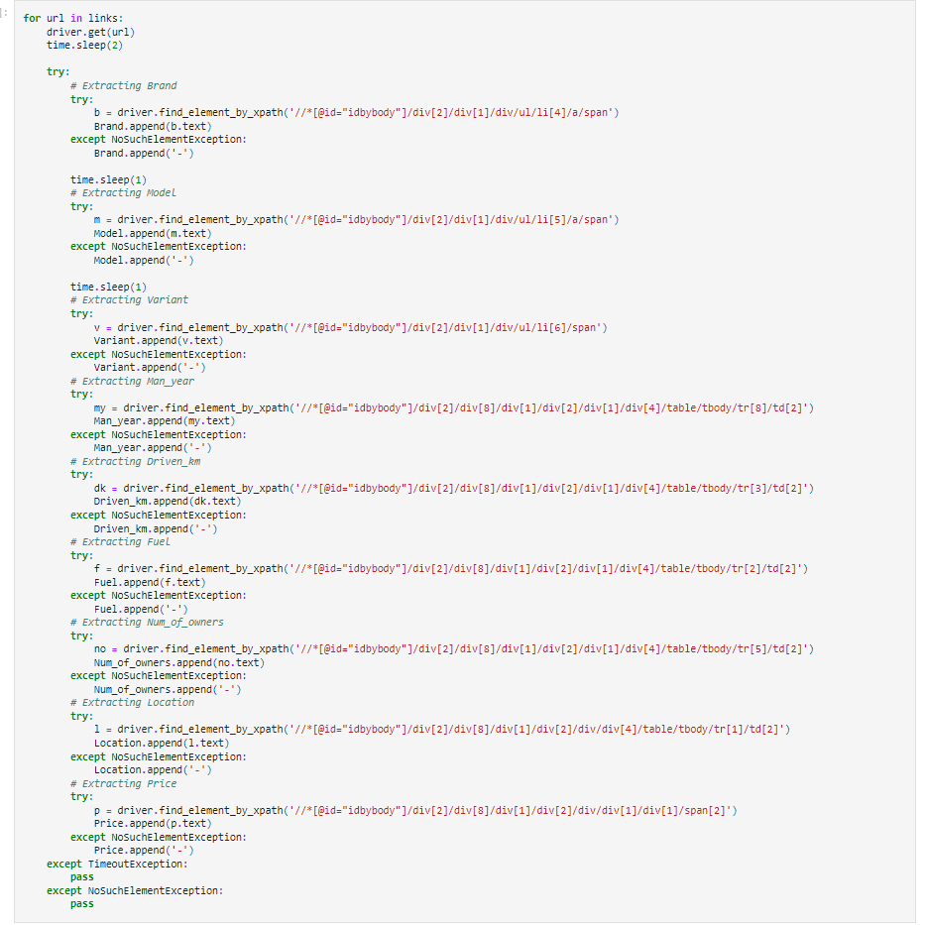
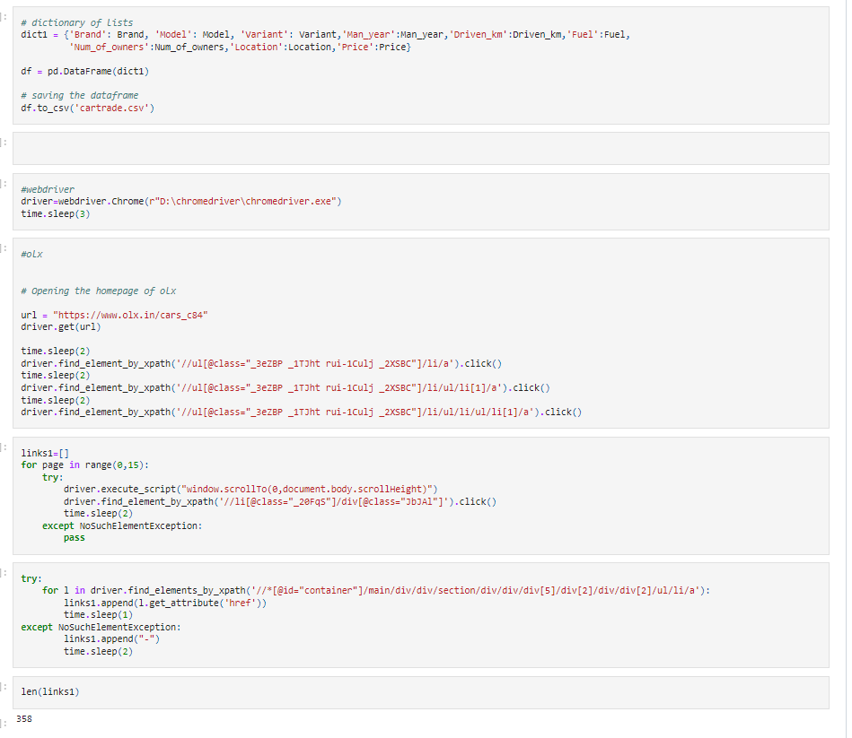

Slide 8
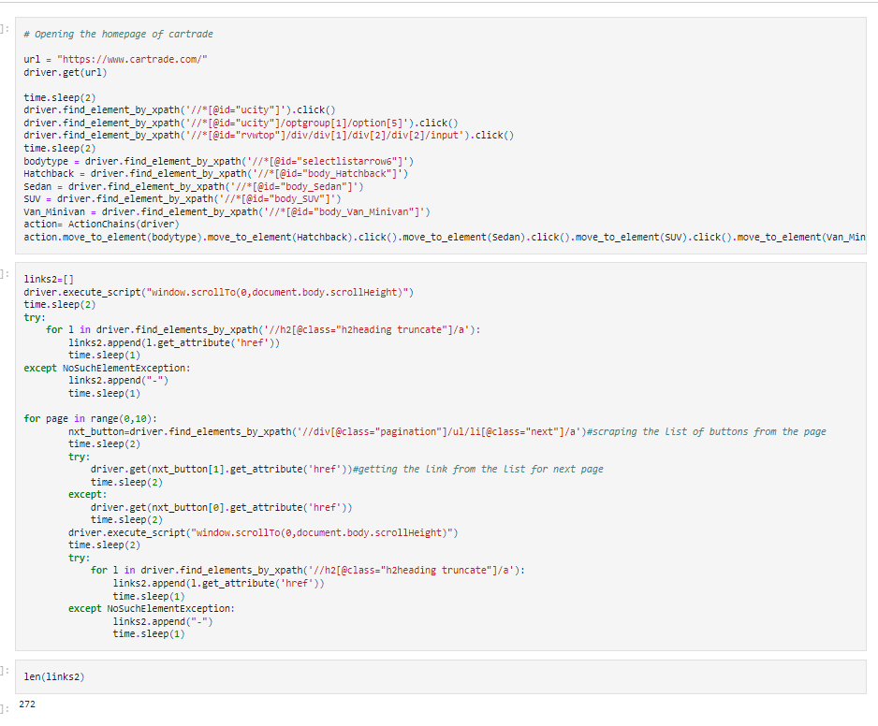


Slide 9
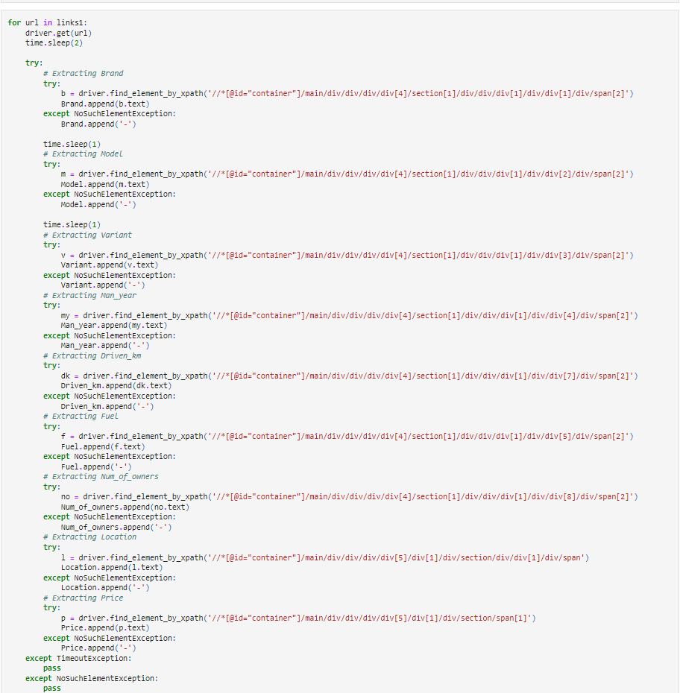
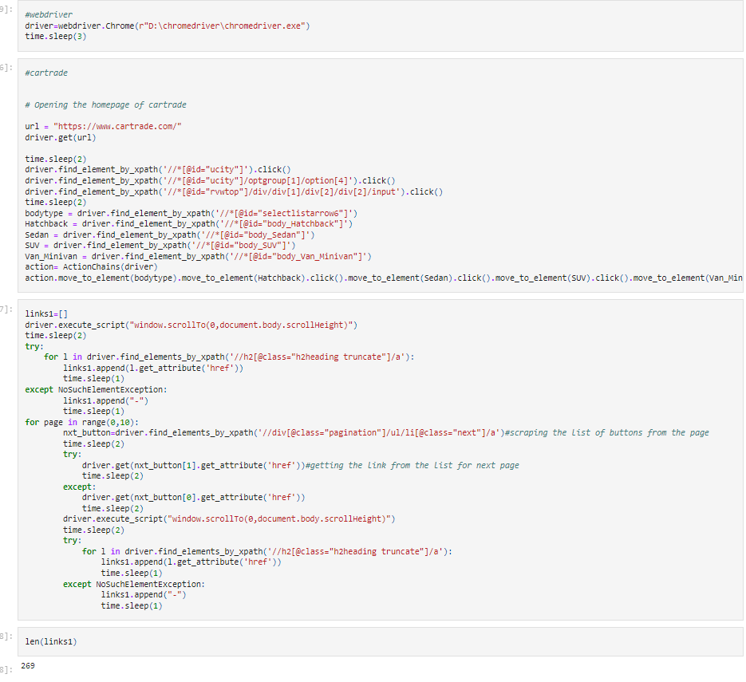

Slide 10
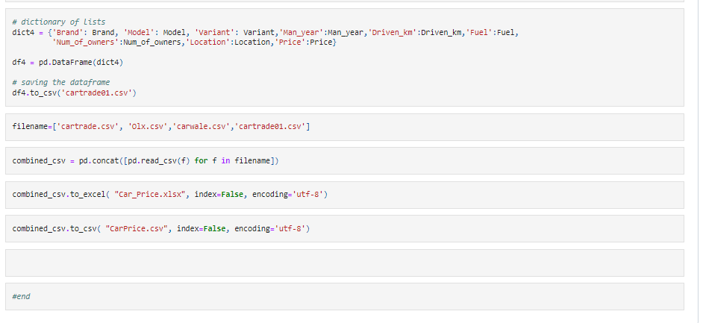

Slide 11
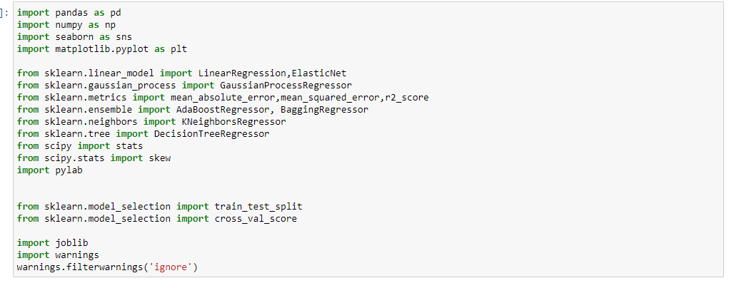
Firstly, we will start by importing required libraries and databases.

Slide 12
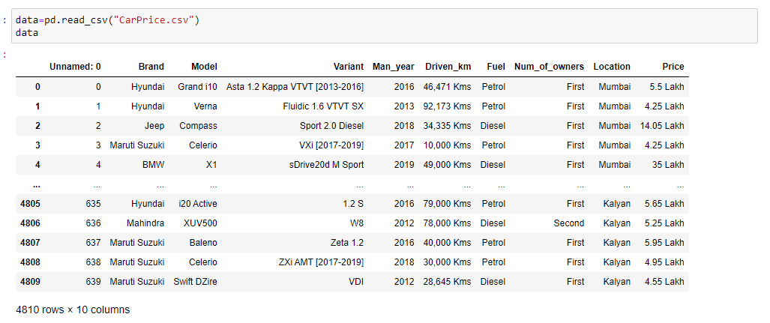
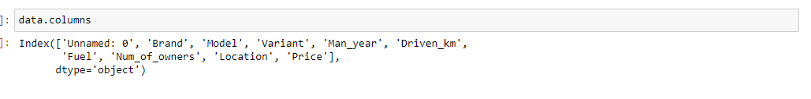
Now Load the datasets carprice.csv file.

Slide 13
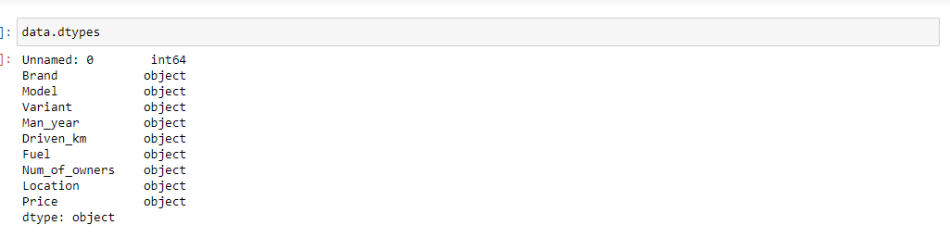
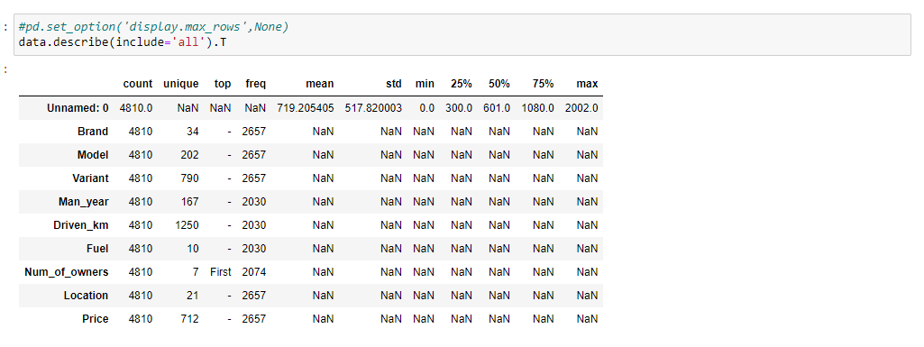
Above is the list of all columns in our datasets.
Our datasets has 4810 rows and 10 columns .
We can see both type of columns numerical and object type.

Slide 14
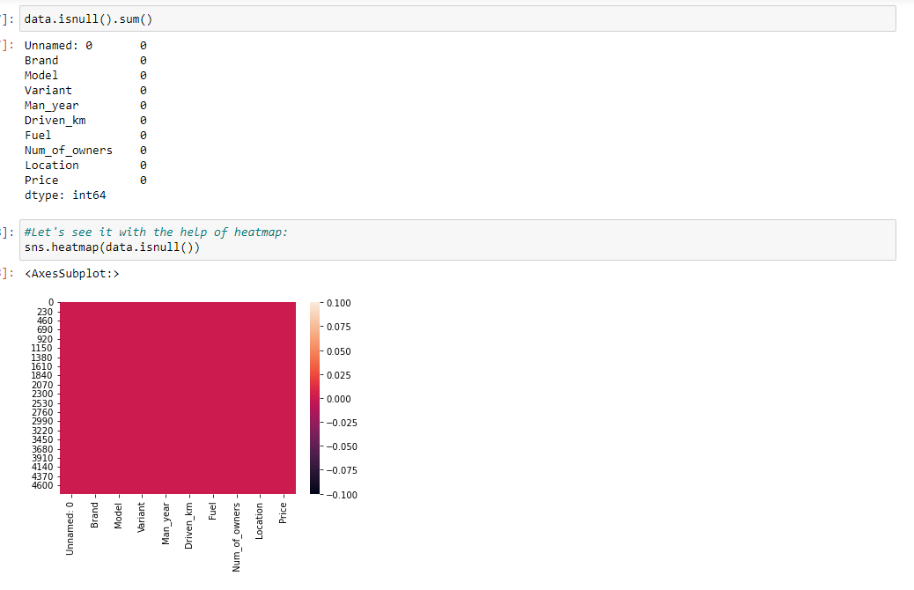
We can see - in some variables most frequently value. We will work on it.
We can see count is all same for all variable, let's check for null values now:
Our datasets does not contain any null values.

Slide 15
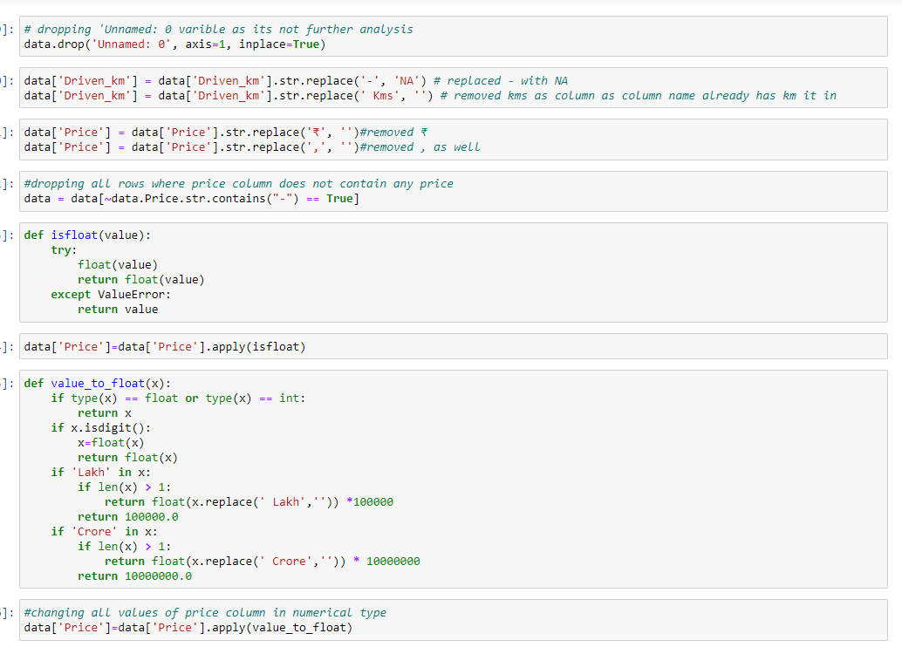

Slide 16
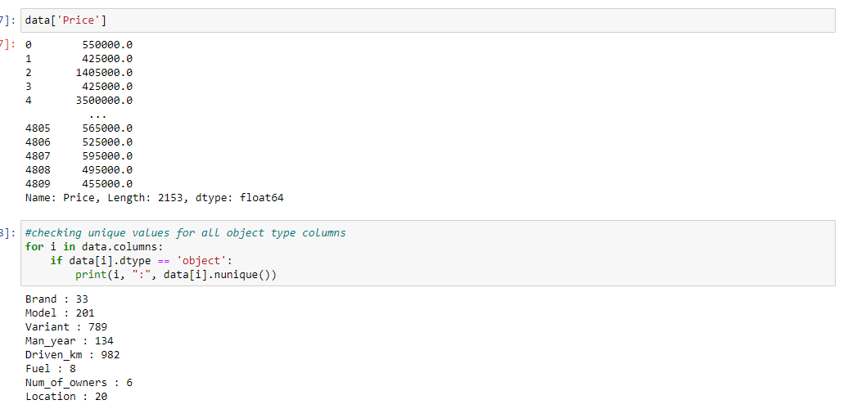
We can see manufacturing year has 134,,

Slide 17
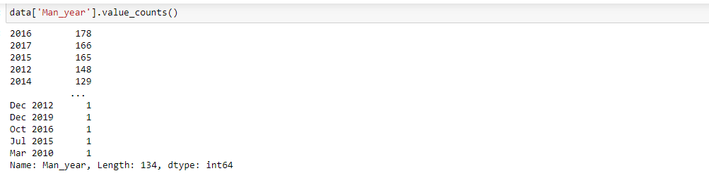
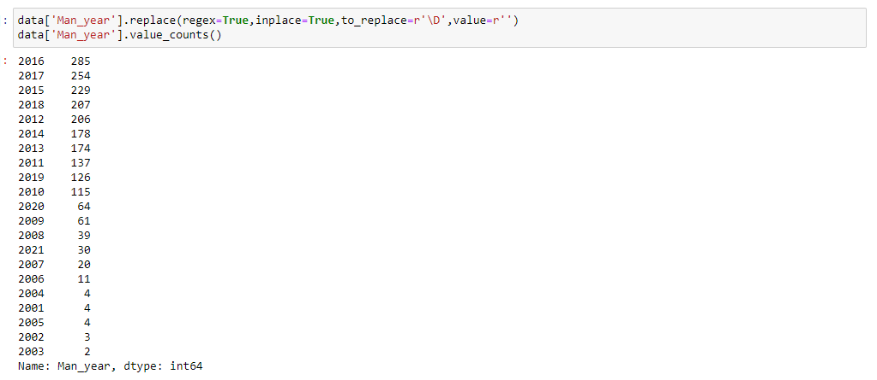
some values contain month as well. Let's remove months and only keep year.

Slide 18
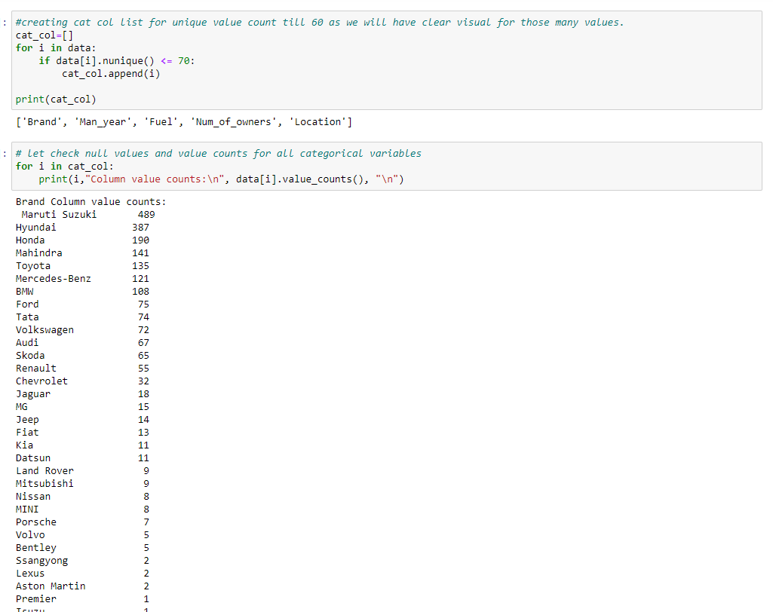

Slide 19
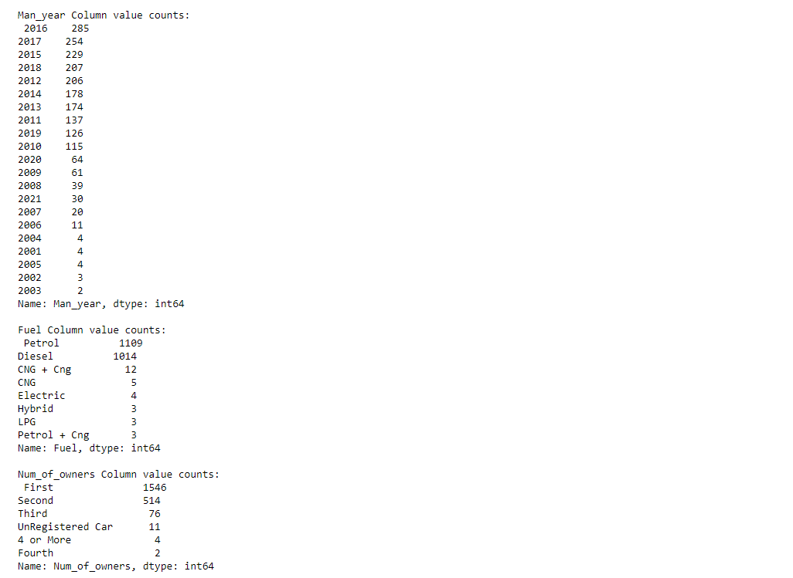

Slide 20
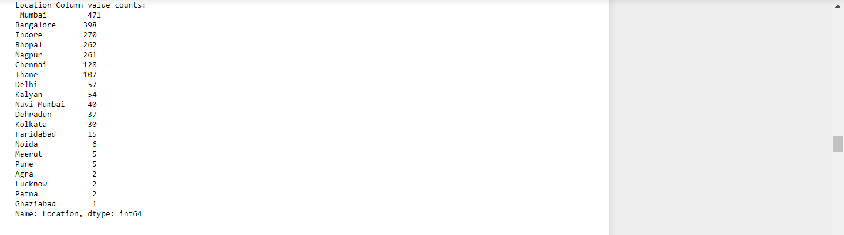
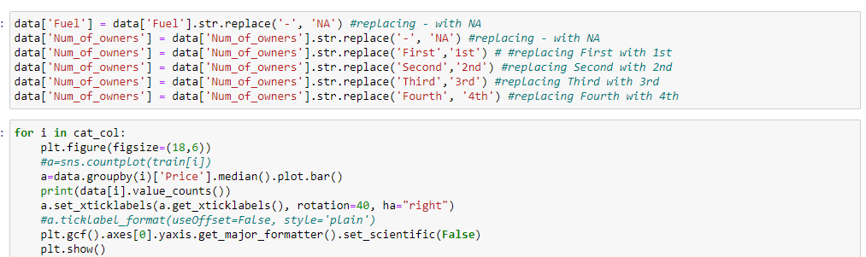
Fuel variable has - value in it. And Number of owners has same value with different format. let’s make required changes.

Slide 21
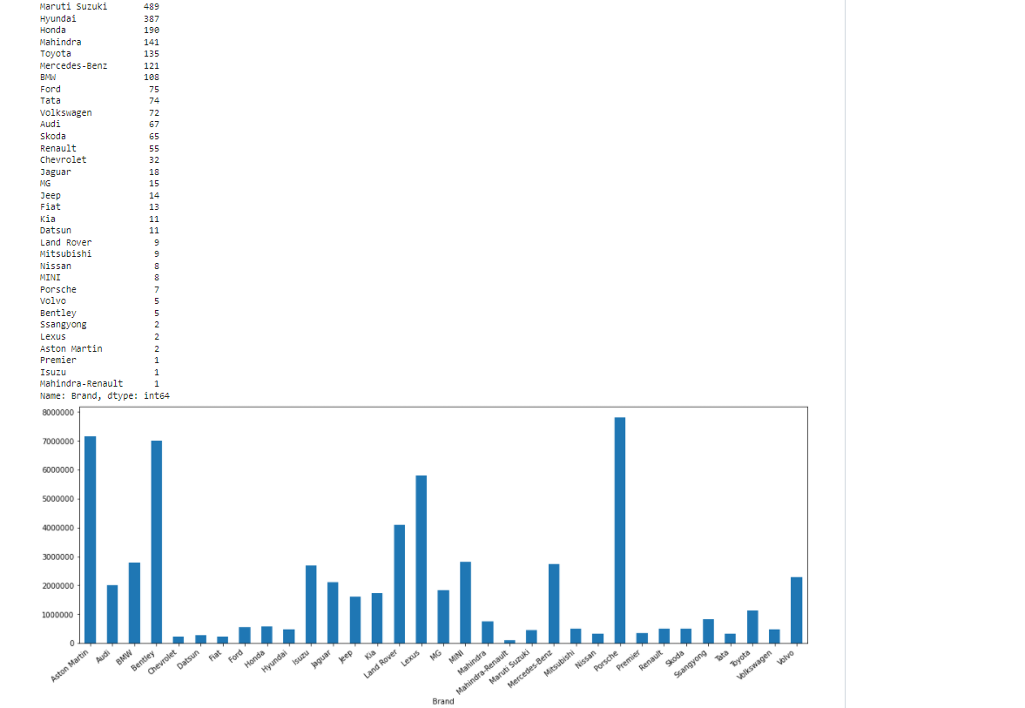

Slide 22
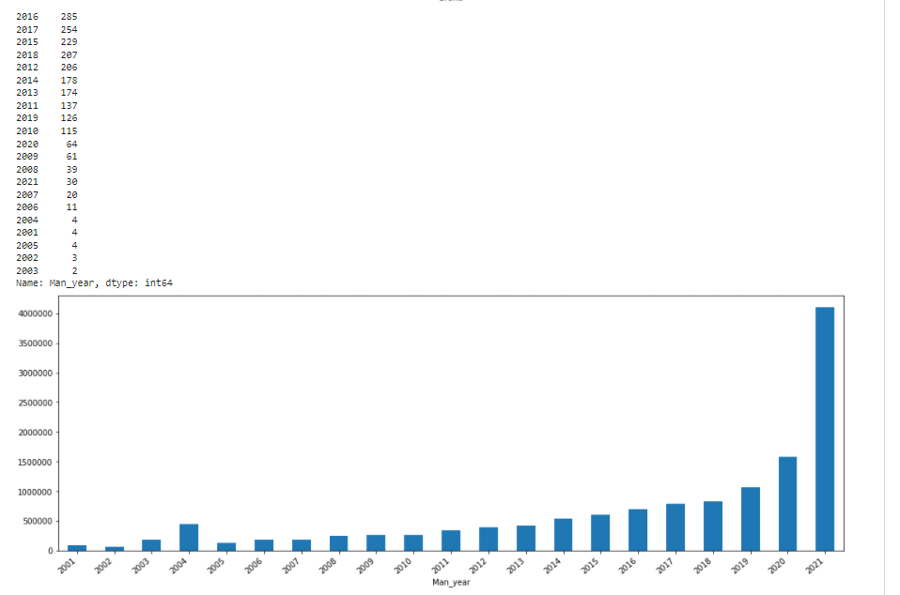

Slide 23
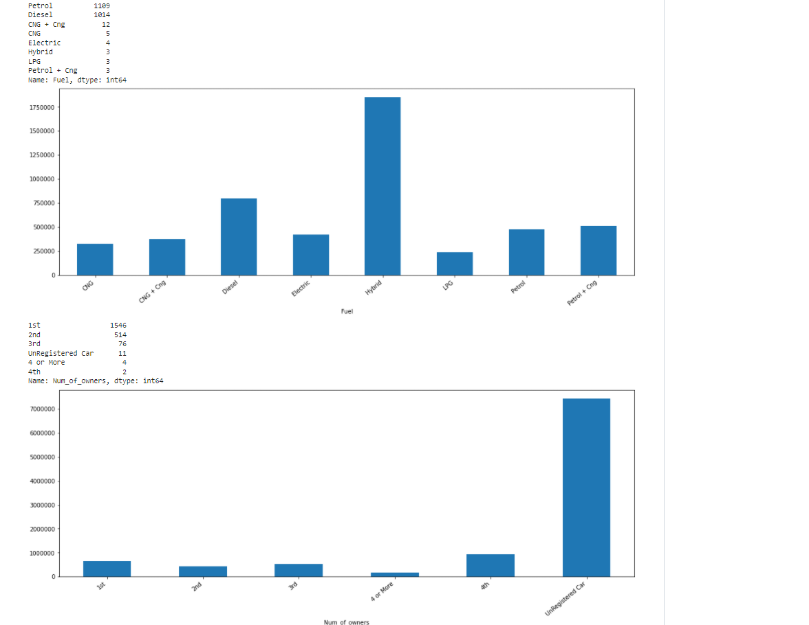

Slide 24
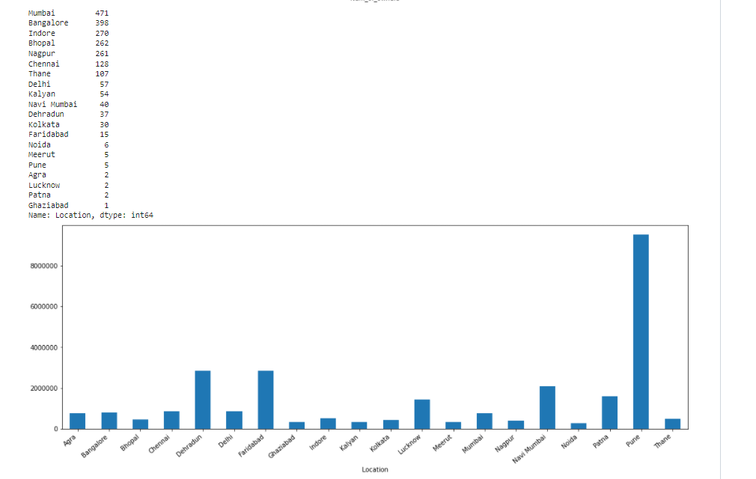
Highest price is for Porsche and maximum count is for Maruti Suzuki and then Hyundai.
Highest price is for manufacturing year 2021, maximum count is for year 2016 and 2017.
Highest price is for hybrid type of fuel; maximum count is for vehicle with fuel type petrol and Diesel.
With respect to number of owners highest price is for Unregistered Car and maximum count is for 1st.

Slide 25
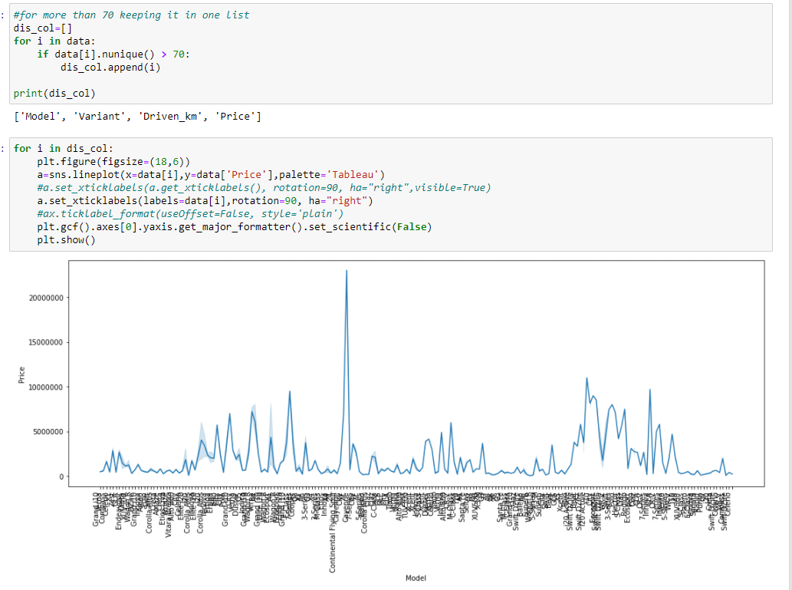

Slide 26
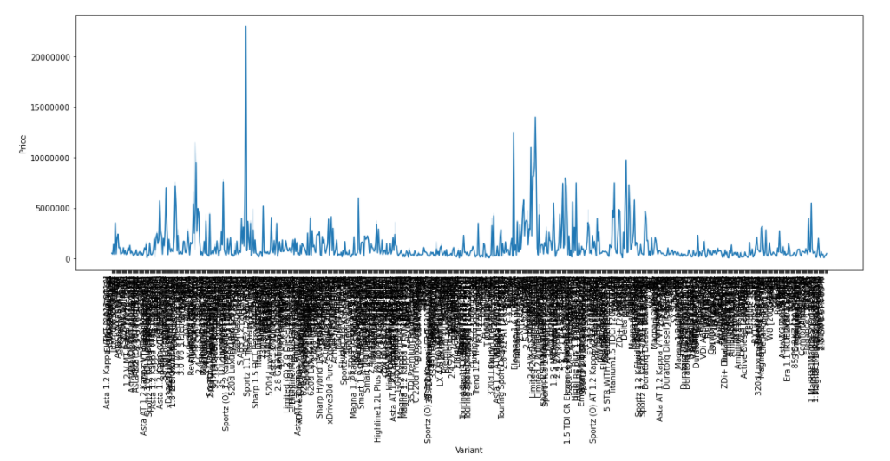
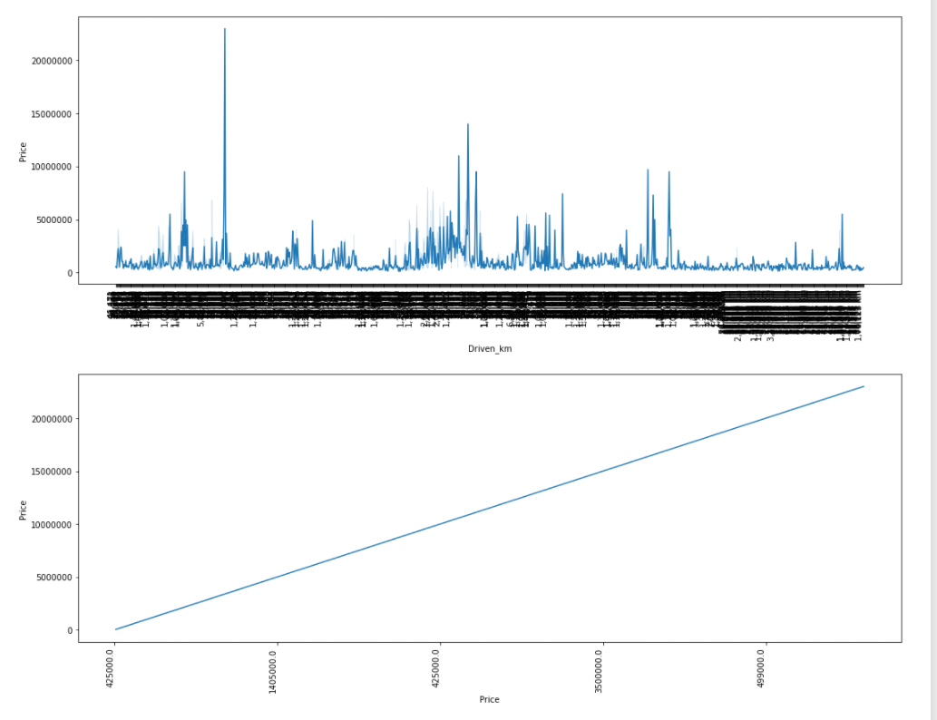

Slide 27
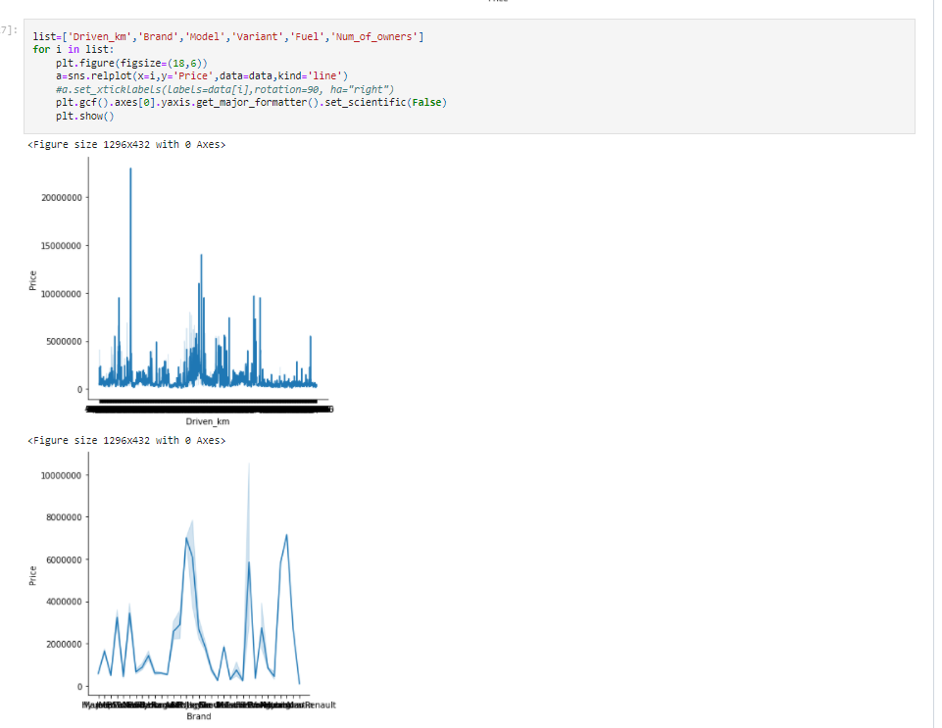

Slide 28
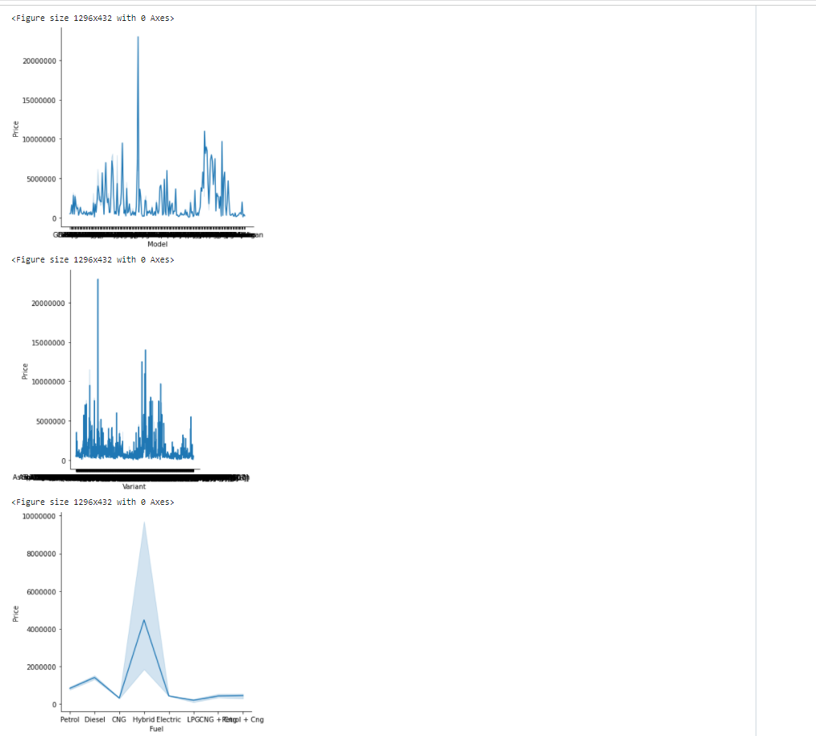

Slide 29
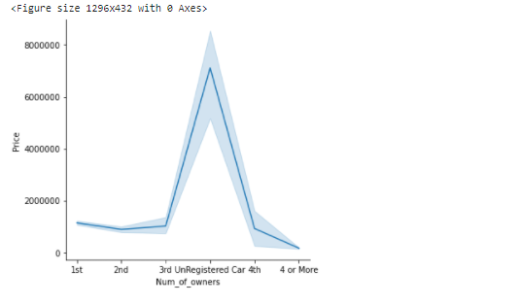
Maximum driven vehicles are for price less than 5000000.
Highest total of price Maruti Suzuki.
Maximum vehicles prices for models are with price less than 1000000.
Maximum vehicles prices for variants are with price less than 5000000.
Maximum vehicles prices for fuel are less with price than 100000.
Maximum vehicles for number of owners are with price less than 400000.

Slide 30
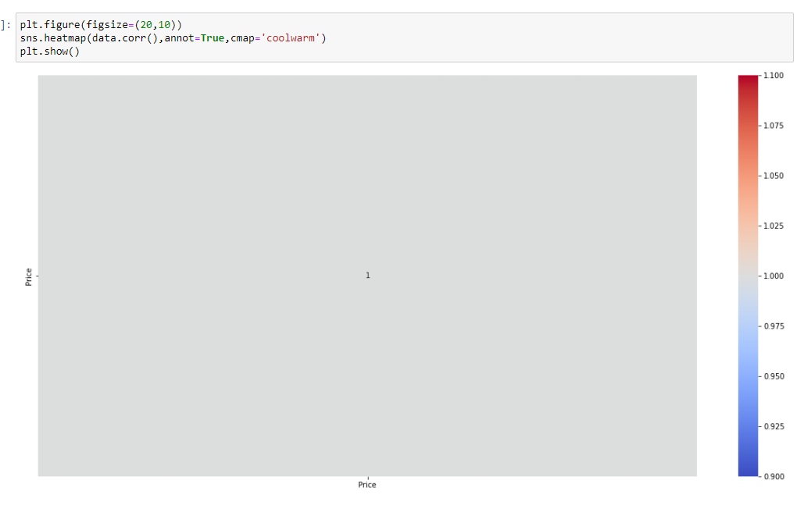
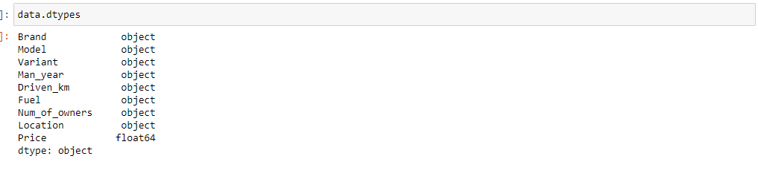
Let's Check the correlation now:
Let's change the data type of other object type columns.

Slide 31
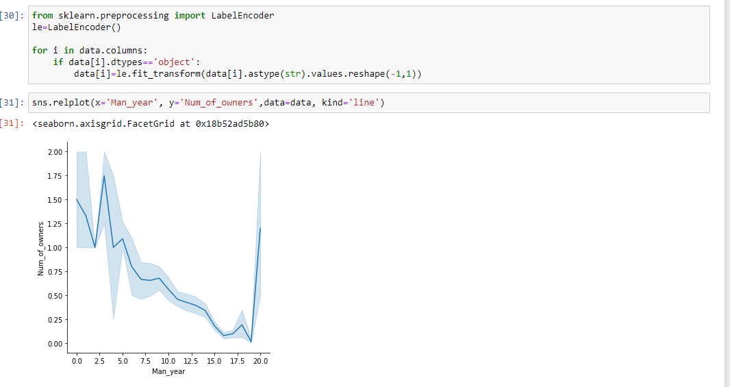
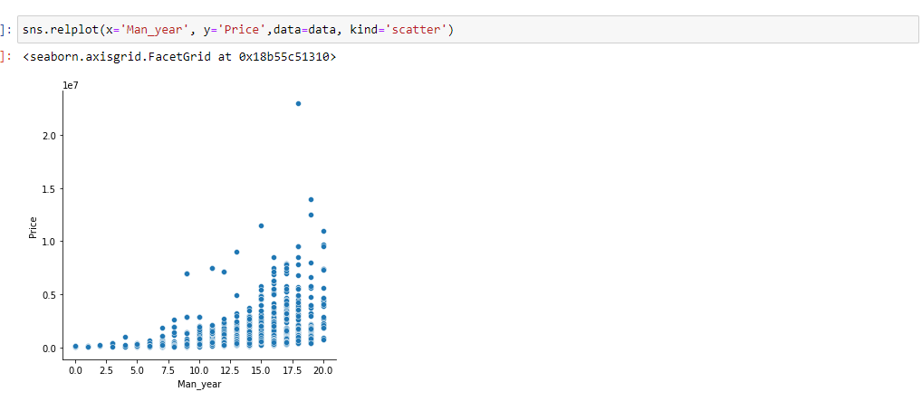
Encoding:
:
Num_of_owners.We can see negative relation between Man_year and Num_of_owners.
Num_of_owners.We can see positive relation between Man_year and Price.

Slide 32
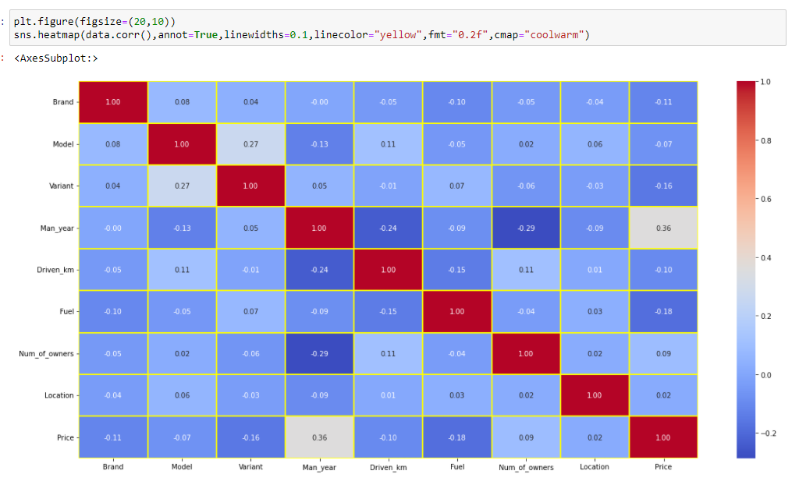
Checking the columns which are positively and negative correlated with the target columns:

Slide 33
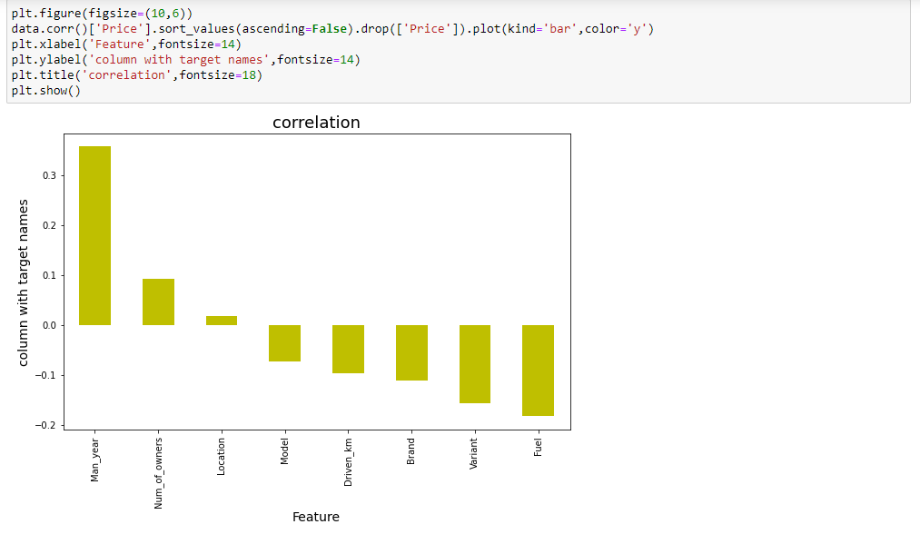
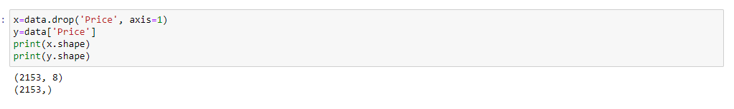
Our target column Price is positively correlated with Man-year and has negative correlation with Fuel column..
Other than price all other columns object type hence Skewness and outliers removal is not required.

Slide 34
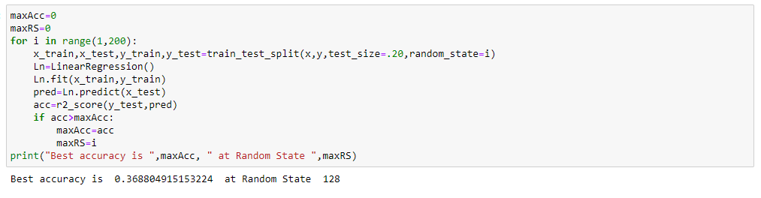
Model/s Development and Evaluation
Finding best random state:

Slide 35
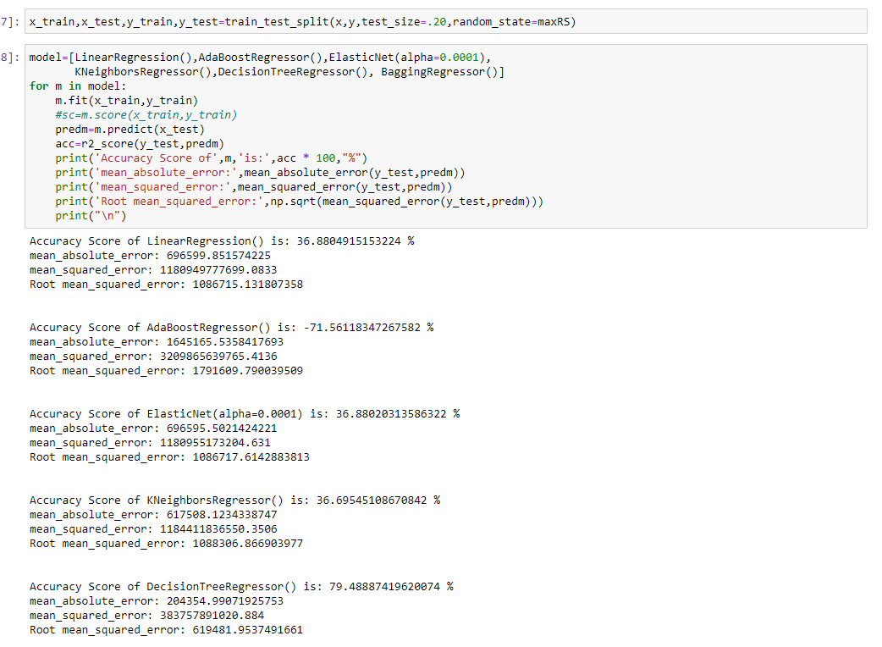
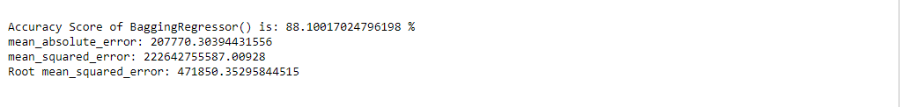
Highest Accuracy is BaggingRegressor which is 88.10%

Slide 36
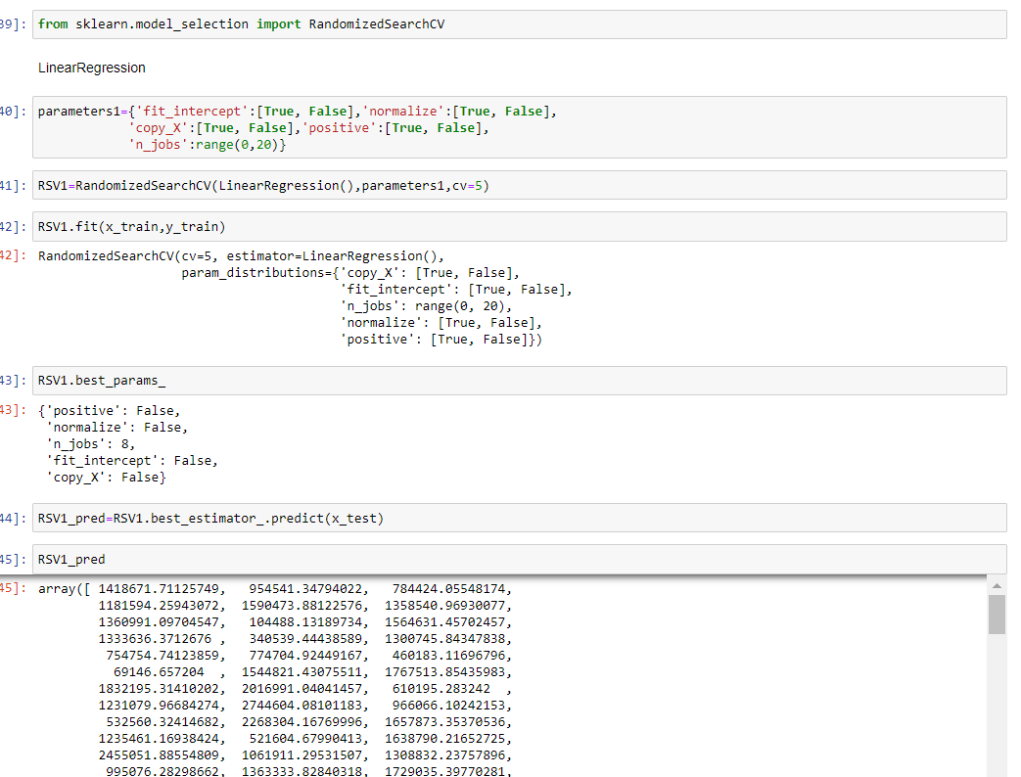
Hyper paramet Tunning:

Slide 37
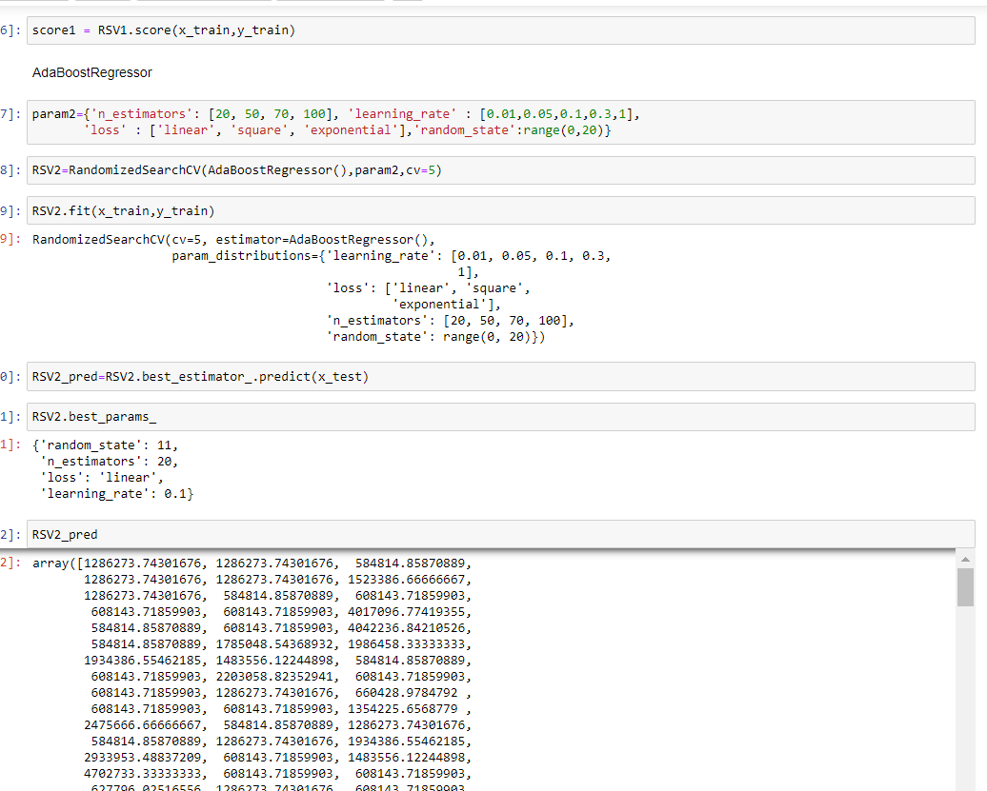

Slide 38
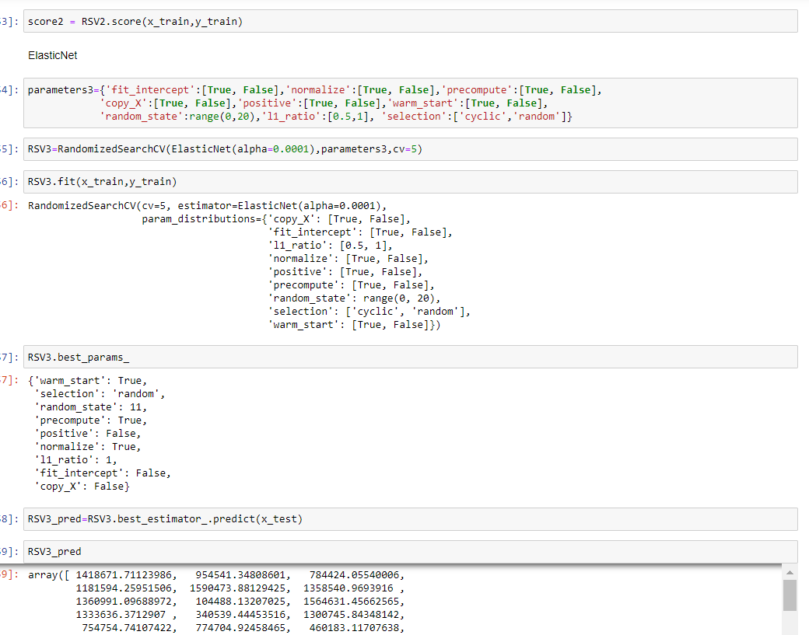

Slide 39
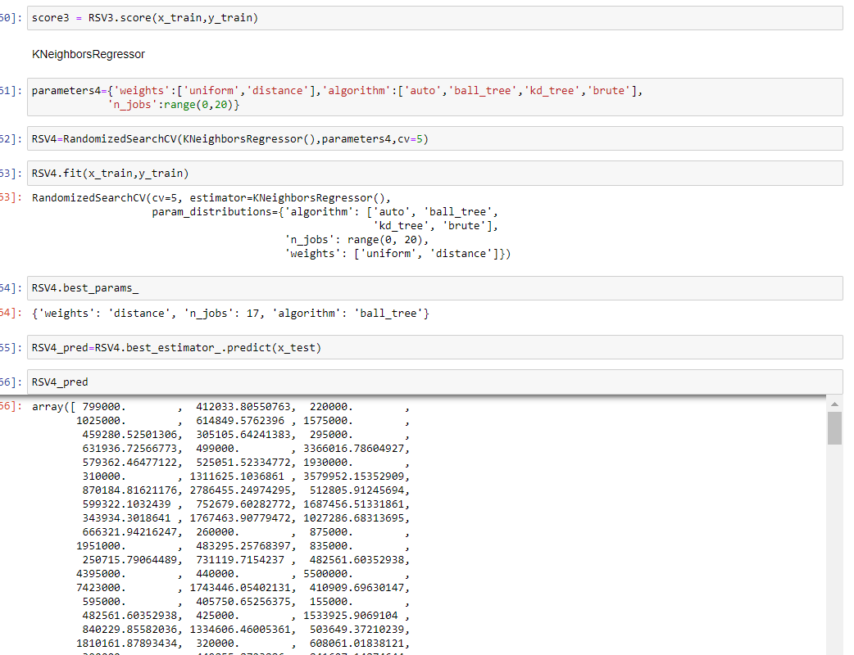

Slide 40
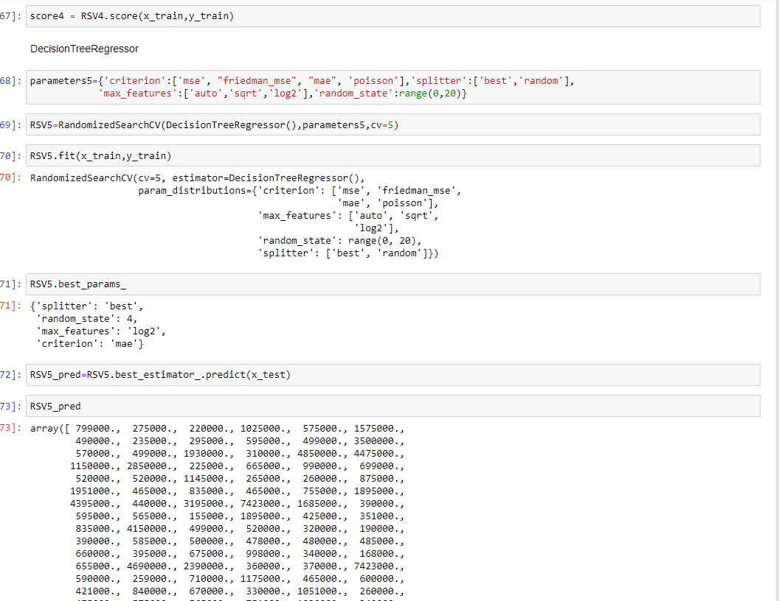

Slide 41


After performing RandomizedSearchCV method accuracy:

Slide 42

Selecting KNeighborsRegressor as final model for saving, as it was having good accuracy with model as well.

Slide 43

Savings The Best Model:

Slide 44
CONCLUSION
In the Car Price Prediction, I have extracted Brand, model, variant, manufacturing year, driven kilometers, fuel, number of owners, location and at last target variable Price of the car from different websites then saved the extracted csv file into one excel sheet. Our dataset mainly consists of 10 columns and 4810 rows. We have one column named Unnamed: 0 however that is not required for further analysis.
Then I did some preprocessing like dropping replacing ‘-‘ with NA , Converted price column into numeric, removed alphabets from Driven_km and Man_year and then removed duplication of values. Then I have performed some visualization. After encoding object type variables, we have check for correlation.
Trying finding out best random random state and then used same for model building. Used 6 methods for model building then with the help of RandomizedSearchCV I have tried to improve accuracy. Finally, I decided to go ahead with the KNeighborsRegressor and saved the model.

Slide 45


